Slide 1

Modes of Operation

Slide 2
Block Cipher Operation
When multiple blocks of plaintext are encrypted using the same key, a number of security issues arise. To apply a block cipher in a variety of applications, five modes of operation have been defined by NIST.
A mode of operation is a technique for enhancing the effect of a cryptographic algorithm.
The five modes are intended to cover a wide variety of applications of encryption for which a block cipher could be used. These modes are intended for use with any symmetric block cipher, including triple DES and AES.

Slide 3
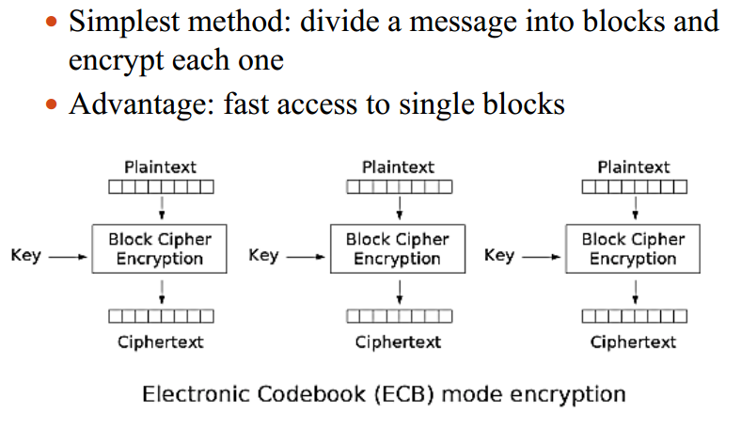
Electronic Codebook (ECB) mode

Slide 4
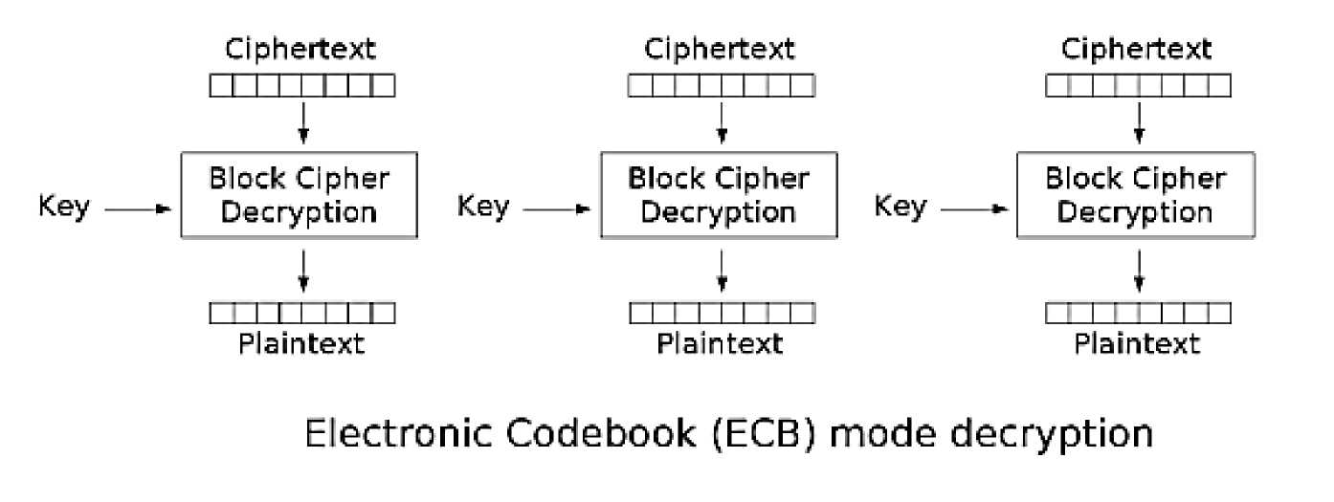
Electronic Codebook (ECB) mode
Best for short messages such as a key
Not secure for lengthy data
Does not hide data patterns well and doesn't provide serious message confidentiality
Each block gets decrypted in exactly the same way.

Slide 5
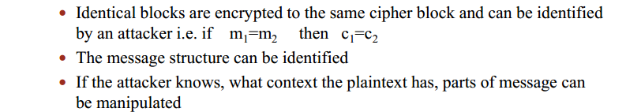
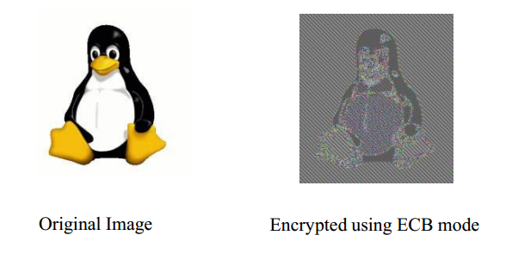
Electronic Codebook (ECB) mode

Slide 6
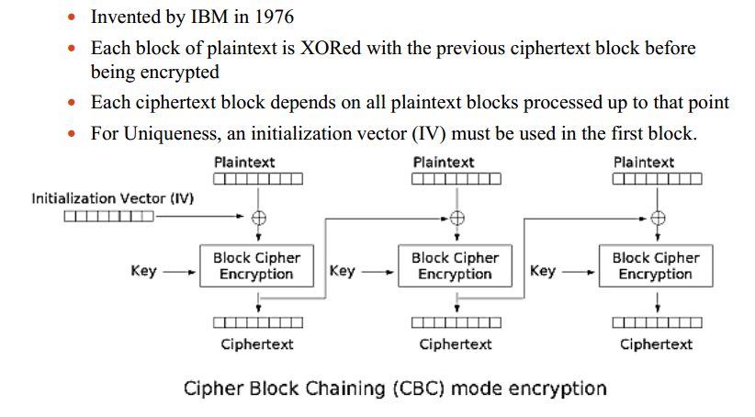
Cipher Block Chaining (CBC) mode

Slide 7
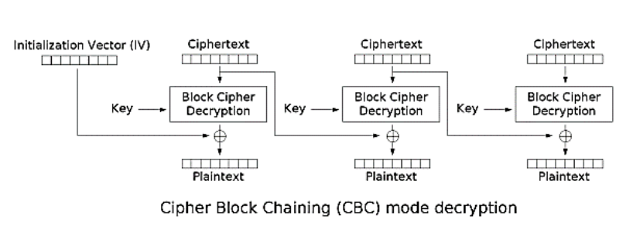
Cipher Block Chaining (CBC) mode

Slide 8
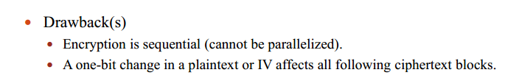
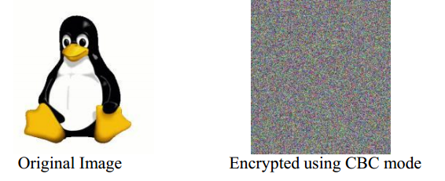
Cipher Block Chaining (CBC) mode

Slide 9
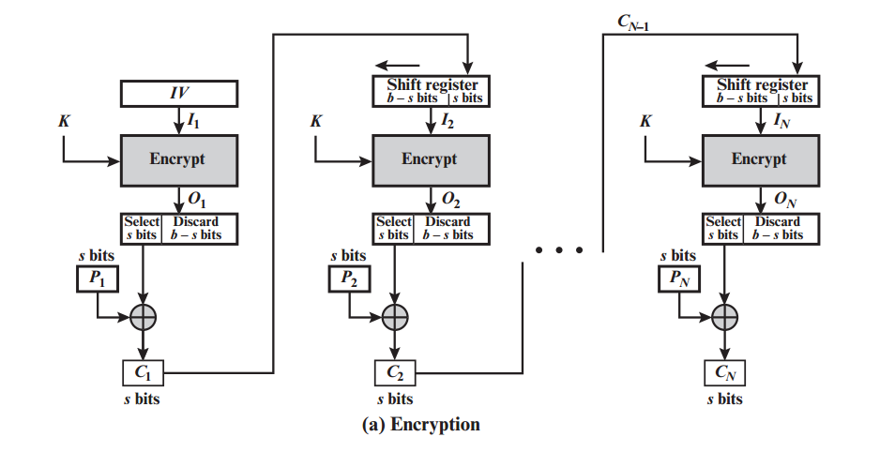
Cipher Feedback (CFB) mode

Slide 10
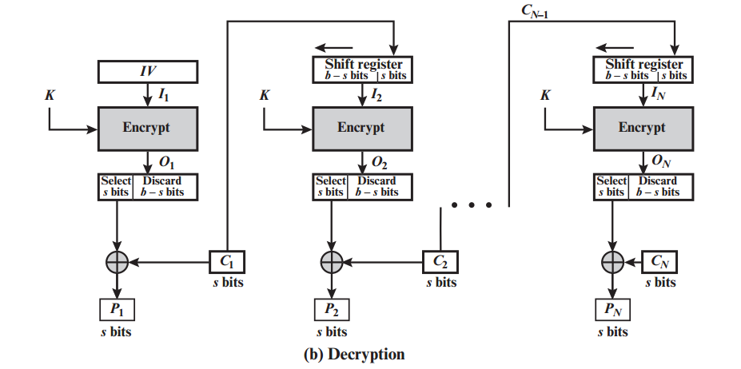
Cipher Feedback (CFB) mode
• CFB decryption is almost identical to CBC Encryption performed in reverse

Slide 11
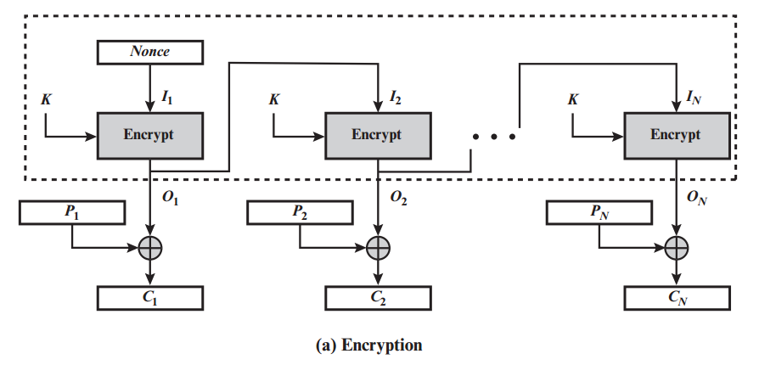
Output Feedback (OFB) mode

Slide 12
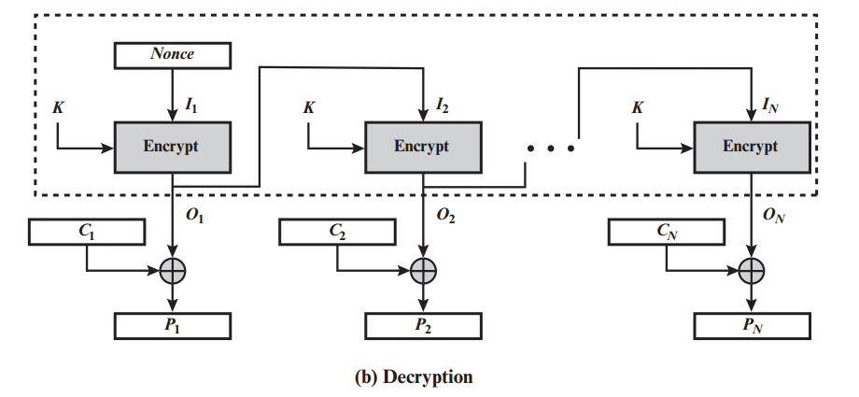
Output Feedback (OFB) mode
Because of the symmetry of the XOR operation, encryption and decryption are exactly the same:

Slide 13
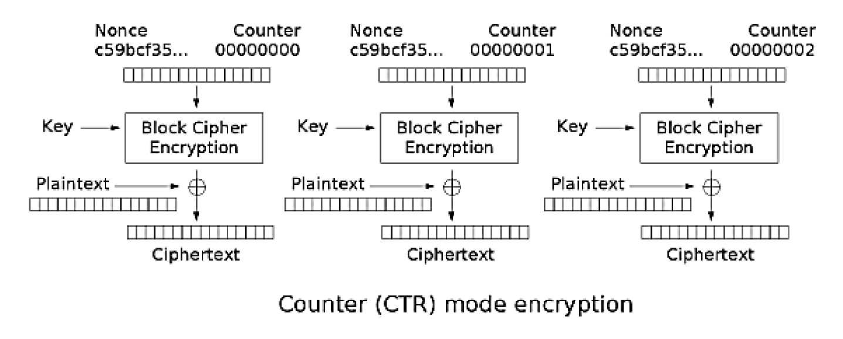
Counter (CTR) mode

Slide 14
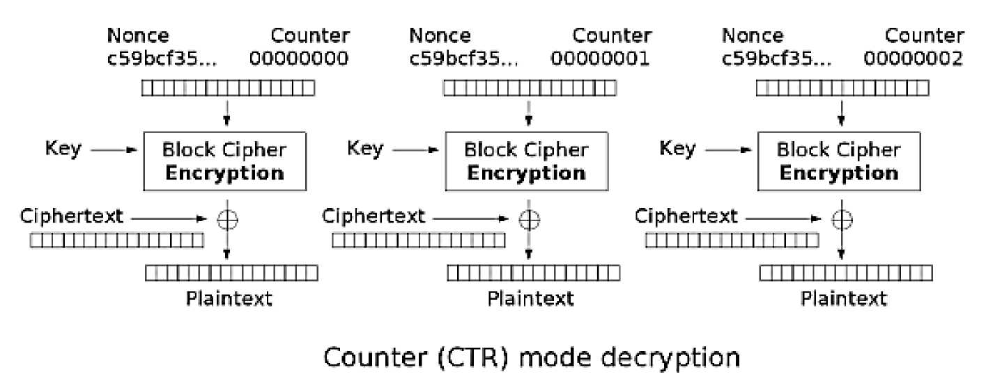
Counter (CTR) mode

Slide 15
